Slide 1

HAPEe
By Prosper Jibunor
1

Slide 2
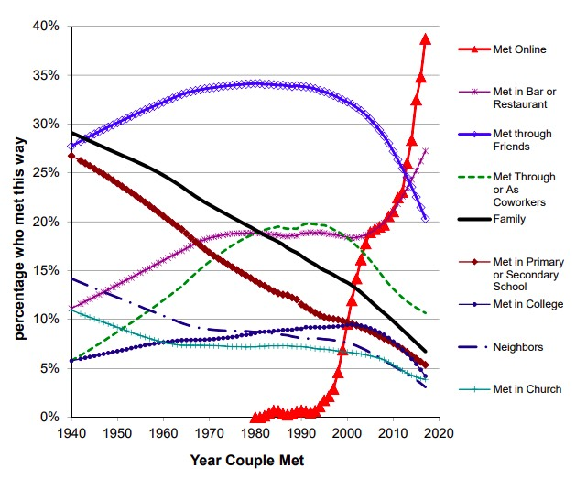
Statistics
2019 Findings from Stanford University
2

Slide 3
The Problem
Current Market
World Trends
White Space
3

Slide 4
Goals
Something Different
Right Audience
New Trend
4

Slide 5



Tools
5

Slide 6
Current Iteration
LOC: 394
Requirements: In Con.
6

Slide 7
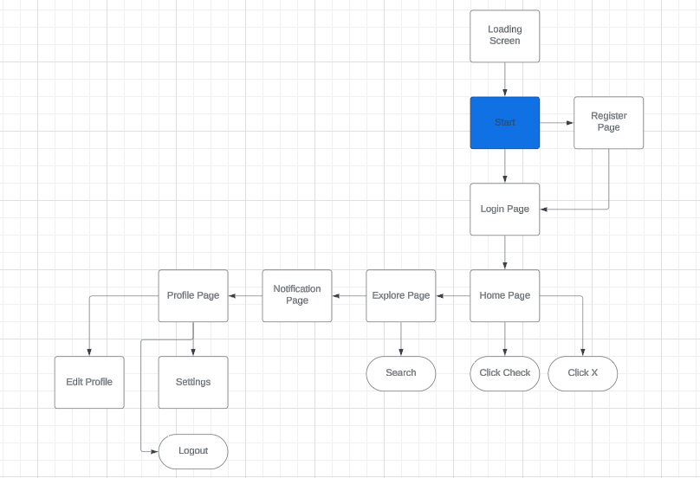
Project Architecture
6
7

Slide 8
Future Plans
Build upon the idea for innovation
Help the world
Beautify for Optimal User Experience
8

Slide 9
Milestones
Milestone 1 – 3:
Begin & Finish Creation of Prototype
Date: 3/27/24
9

Slide 10

Prototype Presentation
10

Slide 11
Bootup & Login Demo
11

Slide 12
Landing Page
12

Slide 13
Questions?
13

